Slide 1
Peer 101: Leveraging Lived Experience
Niki Howenstine, Director of Recovery
Indiana Family and Social Services Administration
Division of Mental Health and Addiction
May 21, 2024
Notes:
Thank Jay
Excited for opportunity

Slide 2
Why Lived Experience?
Lived experience is what connects us and makes us feel safe.
Notes:
Gained knowledge through direct, first-hand involvement
Not assumptions and constructs from research or media
Opposite of “not lived”- book knowledge or learned knowledge
[personal story]

Slide 3
What IS a Peer?
A Peer is a person who has progressed in their own recovery from a mental health and/or substance use concern.
A Family Peer is a person who has lived experience parenting a child with a mental health and/or substance use concern.
Both are willing to self-identify as a peer and work to support others with similar experiences.
Because of their life experiences, such persons have expertise that professional training cannot replicate.
Notes:
provide a space to feel accepted and understood.
acceptance, understanding and validation
roadmap to help others: develop goals, strategies for self empowerment, building self determined lives

Slide 4
DMHA’s Peer Certification
In Indiana, a Certified Peer Support Professional (CPSP) is an individual who utilizes their lived experience combined with formal training to instill hope, inspire change, and support other individuals through similar experiences, using personal connection, person centered care, and their shared understanding to navigate their life in recovery.
Notes:
Recent changes to curriculum and name change- thus new definition
We will be getting more into the definition of peers later this morning

Slide 5
History of Peers - National Movement
Promotion of peer-run services began in the 1970’s
Organization and development of self-help groups in the 1980’s
Recovery Community and SAMHSA meet in August 2010
Recovery Community and SAMHSA develop working definition of Recovery:
A process of change through which individuals improve their health and wellness, live a self-directed life, and strive to reach their full potential.
SAMHSA’s Working Definition of Recovery
Notes:
pro-rights movements in the 1970’s
patients’ rights and against stigma and discrimination
promote peer-run services
1980s, consumers of mh services began to organize self-help/advocacy groups and peer-run services with a new vision
learn about the mh system, to gain access to the best services and treatments
fighting for patients’ rights, stigma and discrimination
help themselves and each other
August 2010 leaders in recovery from MH and SU problems and SAMHSA meet to develop definition of recovery
Previous- separate definitions
complicated insurance coverage and systems overall
new def advanced recovery opportunities and clarifies concepts for peers, families, funders, providers and unites movement

Slide 6
History of Peers in Indiana
1988: Key Consumer – Consumer-led nonprofit launches
1999: Indiana Addiction Issues Coalition (IAIC) launches
2015: Recovery Community Organization established in Southern Indiana
2020: Indiana Regional Recovery Hub Network launches
22 Regional Recovery Hubs
Notes:
Locally, need for mental wellness- consumers start Key in 1984
Non-profit in 1988
501c3 in 1992 under all consumer BOD
Advocates for peer support, empowerment- end discrimination against MH
[Sarah Gunther]
IAIC- advocacy and ed around SUD- grants later to expand – first RCO in Indiana for peer support
2015- national news HIV Outbreak linked to injection drug use
Governor declares public health emergency
Planning for community members, resources (first community movement RCO) IAIC sends peers
Community Outreach Center- state IDs, BC, HIV testing, care coord, treatment referrals, vaccinations, employment
Result- state health commissioner testifies before Congress- need evidence based , comprehensive addiction and recovery treatment
COVID-DMHA and IRN to expand access to peers statewide
access to any person needing peer support 1st time ever

Slide 7
Where Are We Now | Peer Certification
Certified Peer Support Professional Certification (CPSP)
Curriculum aligns with SAMHSA National Model Standards
Created by Indiana Subject Matter Experts – Our Peers
Incorporation of Family Peers
Professionalization
Removal of Barriers
Notes:
April 2023 National Model Standards
CPSP alignment
DMHA priorities: Build Infrastructure, Grow Workforce, Enhance Quality, Increase Access
holistic approach incorporating MH, SUD and the family
a no wrong door approach to peer support
recovery time, costs and fees- full time trainers w/lived experience- Ivy Tech
Crisis and Crisis Supervisor/monthly

Slide 8
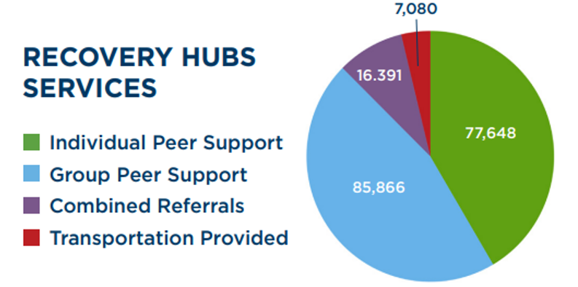
Where Are We Now | Recovery Hubs
Next Level Recovery Report December 2023
Notes:
no barrier access to peer support services and recovery resources
[representatives of hubs here today]

Slide 9
Where Are We Now | Infrastructure
Recovery infrastructure to include mental health, crisis, substance use disorder, trauma
Elevating the value of peers within recovery ecosystem
Inspiring hope through transparency in our recovery
Ensuring standards and sustainability through RCO certification
Notes:
20 Regional Rec Hubs offering Peer Support, 18 Rec Cafes, Numerous other grassroots recovery orgs
Better understanding of funding streams overlapping with recovery to ensure cross care and communication
Peers present throughout behavioral health system
Summer of Recovery tour - instill hope, decrease stigma and celebrate a life of recovery
Legislation for RCO’s- House Bill 1249 to take effect July 1, 2024 amending Indiana Code allowing DMHA to provide standards for certification- codifies the need and importance of recovery community organizations

Slide 10
Where Are We Now | RCO Certification
Independent, grassroots, non-profit organization providing a variety of activities to all community members recovering from substance use, not restricted to individuals enrolled in a specific educational, treatment, or residential program.
https://www.indianarecoverynetwork.org/recovery-community-organization-certification/
Notes:
501c3
3 Core principles - Recovery Vision, Authenticity of Voice, Accountability to the recovery community
support at least one of three core strategies –
Public education and awareness
Policy advocacy
Peer based and other recovery support services and activities.
Follows FAVOR National Standards

Slide 11
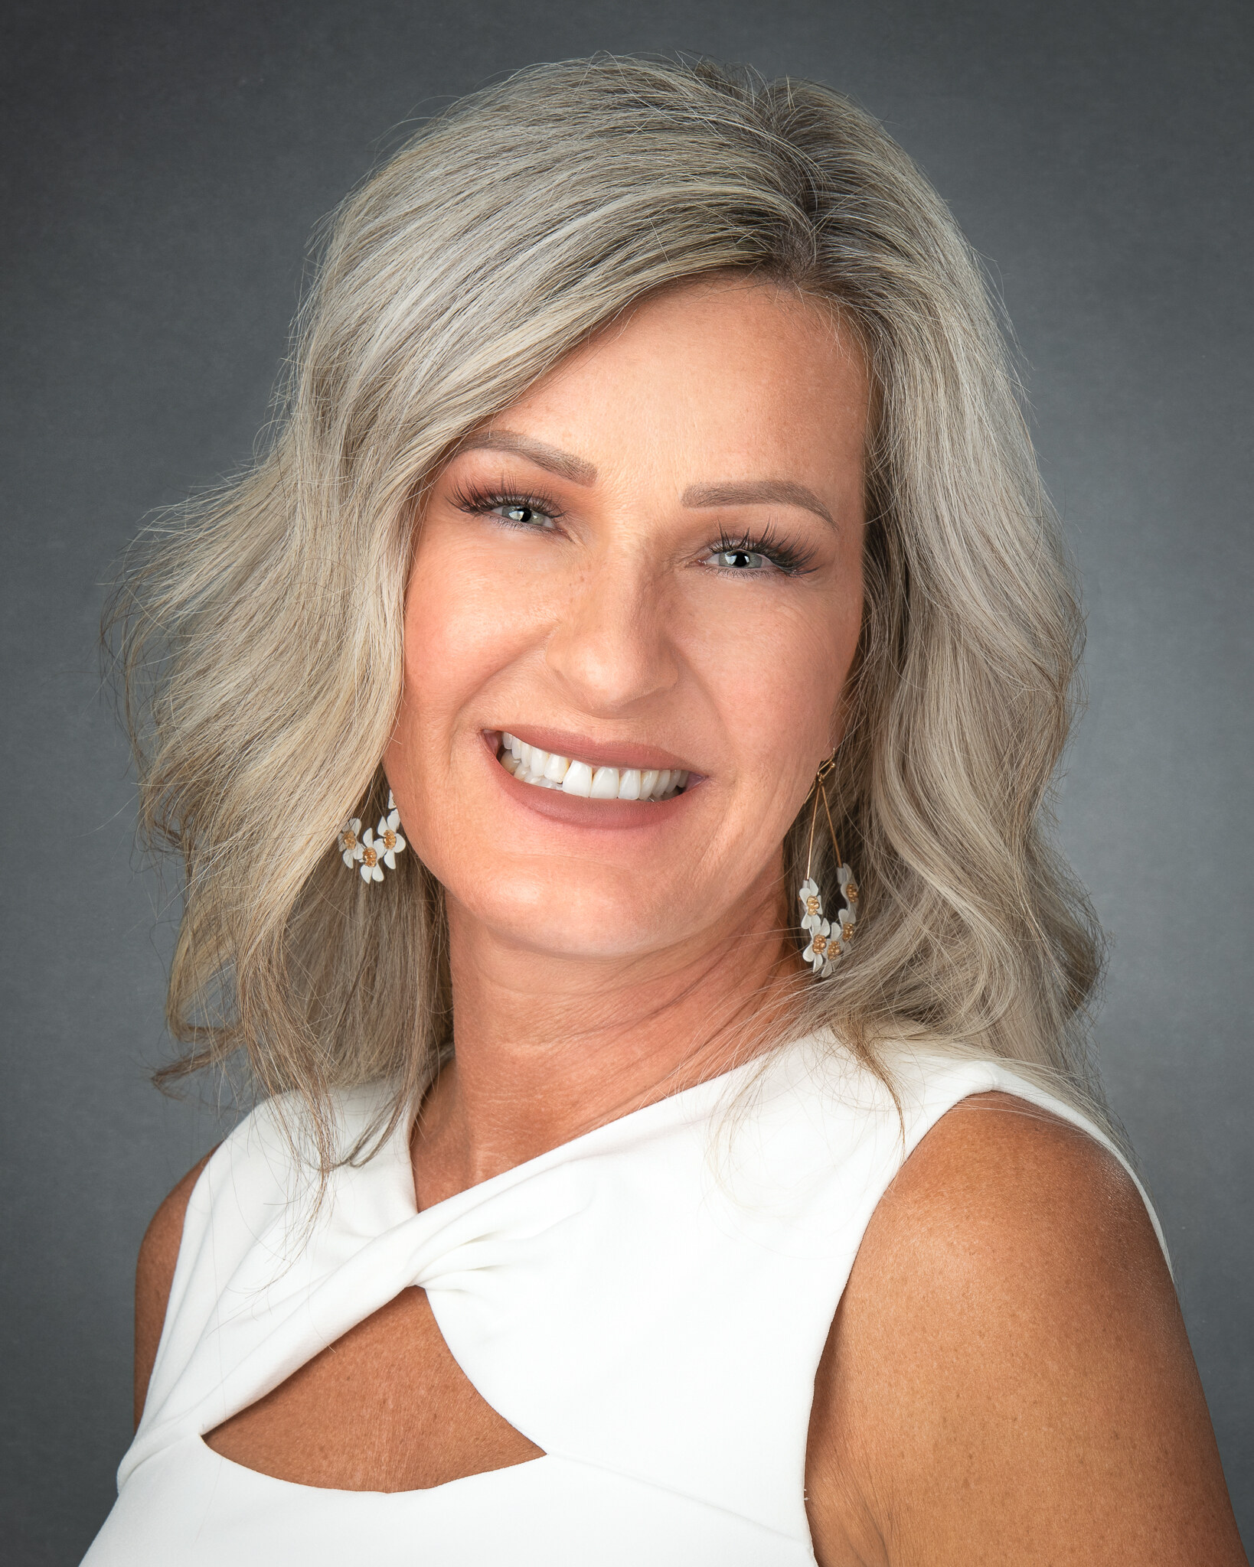
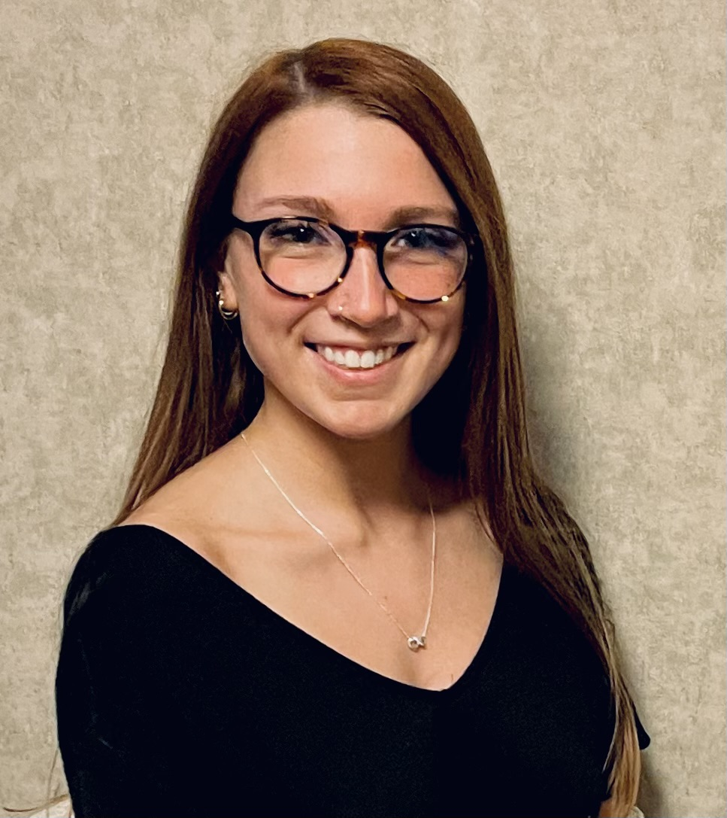
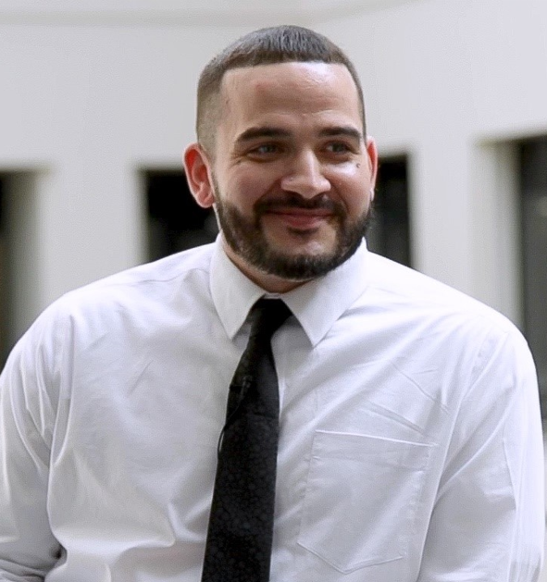
Where Are We Now | Peers at DMHA
Niki Howenstine Danica Fultz
February 2022 February 2023
Andrew Fuquay
January 2024
Notes:
[Reference previous lived experience at DMHA] over two decades
2021 began the expansion of the Recovery Team
2024 furthered that expansion with the hiring of a Peer Program Manager

Slide 12
What’s Next | Recovery Team
Updating Recovery Team’s website
Continuing Education Unit (CEU) requirements
DMHA’s implementation of Peer Supervisor Certification
Establish a workforce ladder for peers
Notes:
Name change
Making information about recovery, peers, more accessible through updates to the website.
CEUs to elevate professionalism- FAVOR
SAMHSA Natl Model Standards- Supervision
peer supervisors have direct experience as a peer worker
knowledge of the peer worker’s role
principles and philosophy of recovery and resiliency
familiarity with the code of ethics

Slide 13
What’s Next | Infrastructure
Regional Recovery Hubs
Recovery Community
Organizations
Recovery Community Centers
Notes:
RCC- are peer-operated centers that serve as local resources of community-based recovery support.
working on criteria for Recovery Community Centers this year
RCCs to address Recovery Communities that do not want to become certified or do not fit the model of certification
recognized by the state and part of the Recovery Infrastructure
More to come
Hubs expand our ability to connect Hoosiers with mh and sud- TI-ROSOC
(RCO) is an independent, grassroots, non-profit organization- no barrier

Slide 14
What’s Next | Support
Mandatory Supporting: Harm Reduction for Mandatory Reporting
Framework that shifts our profession away from positions of surveillance and fear to that of agency and humanity; moves our profession away from responding with punitive measures to reflecting the true responsibility of social workers as supporters to the families and communities we serve.
Notes:
Harm reduction is a growing movement in recovery
A “mind shift” that is peer driven and led by lived experience
moving to a non punitive approach to helping others
Recovery Friendly Workplace
prioritizing stronger relationships with “boots on the ground” understand the issues and often have already defined solutions
Watch for more to come on this- call to action- if you’re interested in being involved in this let me know

Slide 15
Support = Success
Accepting people where they're at in their journey
When people feel loved and accepted
That we know it’s [recovery] possible
That it is accessible to every person that wants it, not just the elite
I feel safe and loved and happy and nobody does or says anything [derogatory]. They love you, period.
I think people are softening because they see that if you just treat people like humans, they'll start acting more human. [harm reduction]
Investing in Recovery Communities 2024
Notes:
February 2022, a project team convened to study the return on investment for Indiana’s recovery communities. The statements above came from interviews with individuals who are seeking supports, including peer support, and the impact such supports have had on their recovery journey. The full 94-page research report in the future

Slide 16
Thank you!
Niki Howenstine, Director of Recovery
Indiana Family and Social Services Administration
Division of Mental Health and Addiction
Niki.Howenstine@fssa.in.gov
PeerSupport@fssa.in.gov

