Slide 1

VR Basics,
Declinations,
VLM Project Preview, & Spring Cleaning
Presented by Angie Nussmeyer
Co-Director, Indiana Election Division
Northern & Southern District Clerk’s Conference
March 2025
Background photo created by kues1 - www.freepik.com

Slide 2
Voter Registration Basics
State Voter Registration Forms
  VRG 7 & VRG 11
    Same form, but one has address for IED (VRG-7) on the front & the other allows county to customize return address on front (VRG-11)
  Federal Voter Registration Form
    Standardized registration form for all US states & territories
      Not all questions on federal form need to be answered
        For example, Indiana does not have party affiliation when registering to vote so no need to include on federal VR form when filing in Indiana
      State specific instructions in the packet found at eac.gov

Slide 3
Voter Registration Basics
Required elements on form
  Age/Citizenship questions
    Must both be marked “yes”
    If one or both marked “no,” must reject registration application
    If one or both NOT marked, must mark as “incomplete”
      Voter can submit a new registration application with marked responses
      May not return registration back to voter; once filed with county VR office, must remain with county VR office
      May not fill out for voter; voter must personally mark
  Signature
    Must include voter’s ORIGINAL signature
      Paper forms may NOT be emailed or faxed
      Exception is Federal Post Card Application (FPCA) & ABS-VPD
    Missing signature? Mark as “incomplete”
IC 3-7-22-5 | IC 3-7-32-1 | IC 3-7-34

Slide 4
Voter Registration Basics
Required elements
  MUST include one of the following ID numbers:
    IN Driver’s License Number or Indiana ID, OR
    Last 4 digits of Social Security Number, OR
    If voter does not have either, mark “NONE” a voter ID number is generated by SVRS
      Voter must be prompted for DLN/SSN numbers by poll workers, but the voter is not required to provide the information
        Remember, voter swears and affirms under penalties of perjury the individual is a US citizen who will be at least 18-years old by November election
IC 3-7-13-13 | IC 3-11-8-25.1

Slide 5
Voter Registration Basics
Required Elements
  Residence Address
    Must be where voter currently resides (See IC 3-5-5 for details)
      CANNOT be a PO Box
      CANNOT be a business address, unless the person also resides there
        SVRS includes a feature to identify the type of address (residential, commercial, PO Box)
        Cannot be used on its face to reject a registration, but SHOULD be used for VR official to investigate to inform decision-making
  Mailing Address
    Can be an address anywhere in the world
    Can be a PO Box
    Can be a business address
IC 3-7-31-5

Slide 6
Voter Registration Basics
Required Elements
  Date of Birth
    Must be 18 on or before date of NOVEMBER election
      Yes, a 17-year-old can vote in a May primary election if registered by primary election registration deadline
        In 2025, it’s possible that a 16-year-old can register to vote as long as they turn 18 by November 3, 2026
    In 2025, if a special election, must be 18 on or before date of SPECIAL election to register to vote
      If an underage voter is already registered to vote, the poll list should include a disclaimer that the voter is under 18 and therefore, ineligible to vote
Optional Elements
  Email Address
  Phone Number
IC 3-7-13-1 | IC 3-7-13-2 | IC 3-7-13-3

Slide 7
Voter Registration Basics
Online Voter Registration
  www.indianavoters.com
  Requires an Indiana driver’s license or Indiana ID card to register
    Pulls BMV signature over to voter record; cannot do the same with SSN or random voter ID number
Full-Service Agencies
  BMV – voter asked if voter wishes to register when getting an ID or driver’s license (meaning a credential)
    Forms available at BMV, but BMV does NOT collect VR forms to turn into county
    Registration during credential transaction comes through your BMV hopper
IC 3-7-26.7 | IC 3-7-14

Slide 8
Voter Registration Basics
Federal Post Card Application (FPCA)
  Dual voter registration & absentee application form created by US Department of Defense
    ONLY used by military, their spouses & dependents & overseas voters
  CAN be filed in 2025
    Most likely just used for voter registration changes
    Absentee only application from Jan 1 to Dec. 31, 2025
      Unless you have a special election, no absentee ballot will be sent to voter this year
      FPCA voter must re-apply on or after Jan 1, 2026 for absentee in 2026
IC 3-7-15 | IC 3-7-16 | IC 3-7-18 | IC 3-7-36 | IC 3-11-4-3

Slide 9
Voter Registration Basics
Voters with Print Disabilities (ABS-VPD)
  Voter with no vision, low vision or lack of manual dexterity to complete a form
    NOT for folks without access to a printer
  Dual voter registration & absentee form
    In 2025, likely just used for voter registration purposes
      If having a special election, then absentee application can be accepted if voter lives in a precinct where election is happening
      For May 2025 special election, Democracy Live is available to support counties with providing an accessible online balloting solution for this group of voters
IC 3-7-15 | IC 3-7-16 | IC 3-7-18 | IC 3-7-36 | IC 3-11-4-3

Slide 10
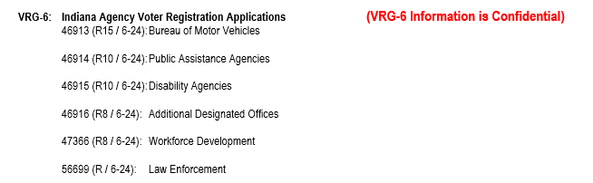


Voter Registration Basics
Full-Service Agencies
  DWD, FSSA & law enforcements agencies have access to special voter registration form called VRG-6
    Must ask IED for form as it is NOT on the public site
      NVRA tracking code uses the state form number
IC 3-7-15 | IC 3-7-16 | IC 3-7-18 | IC 3-7-36 | IC 3-11-4-3

Slide 11
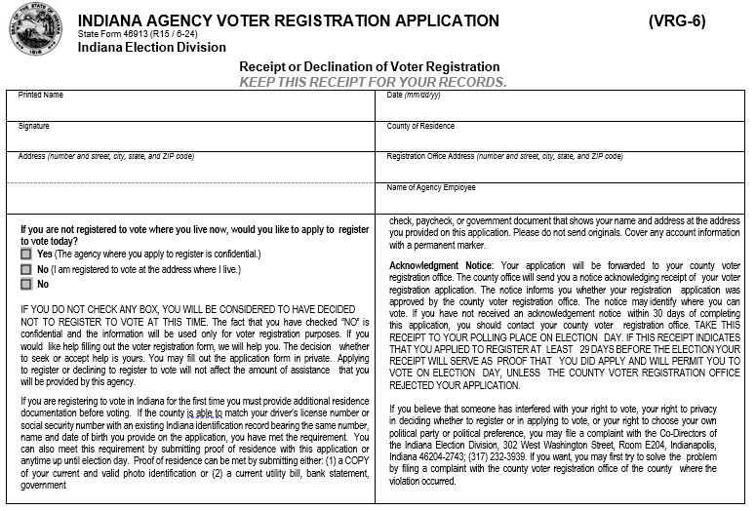
VRG-6 Declinations
Image is the top half of VRG-6 form; lower half is similar to state VR form

Slide 12
VRG-6 Declinations
For ALL full-service agencies EXCEPT BMV….
  Agency files paper VRG-6 forms & declinations with county VR official not later than 5 days after receiving form from voter
    VRG-9 cover sheet is used
  VR official provides VRG-8 form to agency confirming receipt of VRG-6 forms & declinations
BMV VRG-6 & declinations are sent electronically to SVRS
  No need to use the VRG-8 & VRG-9 forms
Process registration half the same as any other VR form
  BMV registrations come through the SVRS BMV Hopper
  All other full-service agency registrations are on paper

Slide 13
VRG-6 Declinations
Review declinations for list maintenance purposes
  Does address on declination match the residence address on their current registration record?
    If a MATCH, cannot be used for list maintenance
      Minor variations in the address are OK (missing Dr. for example)
    If NOT a match, a statewide address mailing confirmation (SAMC) notice is sent to the voter
      Generated in SVRS
      Allows voter to confirm current registration address, update it within their county, or cancel it
      If voter fails to respond after 30-days or the SAMC is returned as undeliverable, then voter’s status is changed to inactive (assuming not in a freeze period)
NOTE: SAMC would NOT be sent if voter’s name does not match; county may wish to follow-up with the voter, though name changes can be handled in multiple ways through the voting process without major impact to voter
IC 3-7-38.2-2(e)(8)

Slide 14
Statewide VLM Project Preview
Anticipate a start date in May/June 2025
  Working to finalize plans now
Postcard (card 1)
  Sent to all active voters in Indiana by non-forwardable mail
    Uses mailing address on their registration record
SAMC-style Card (card 2)
  Sent to voter when card 1 is returned as undeliverable
    Uses forwarding service, if such a request on file with USPS
  Allows voter to confirm, update, or cancel Indiana registration
    Must be returned within 30-days
    If not returned after 30-days or returned is undeliverable, voter’s registration status is moved to inactive, assuming not in a freeze period
IC 3-7-38.2-16.1 | IC 3-7-38.2-17

Slide 15
Spring Cleaning
Election Materials
  Subject to 22-month retention schedule
  Election records from November 2022 or earlier can be destroyed
    May 2023 election materials may be destroyed on or after March 2, 2025
    November 2023 election materials may be destroyed on or after September 7, 2025
IC 3-10-1-31.1

Slide 16
Spring Cleaning
Voter Registration
  Paper registrations for voters moved into CANCELLED status may be destroyed NO EARLIER than two years after the next general election following cancellation
    Example 1: Registration cancelled on Dec. 1, 2020. County VR official can destroy paper record on or after Nov. 8, 2024, which is two years after the general election following the voter’s cancellation
    Example 2: Registration cancelled on Sept. 1, 2020. County VR official can destroy paper record on or after Nov. 3, 2022, which is two years after the general election following the voter’s cancellation
  SVRS database maintains voter’s electronic record in perpetuity
    Paper registrations are to be scanned & added to SVRS documents
IC 3-10-1-31.1

Slide 17
Spring Cleaning
Campaign Finance
  All Committee CFA-4 Reports (except Judge!)
    Records must be kept for FOUR years following Dec. 1 after the election
      Example: 2024 Pre-Election Report filed in Oct. 2024
      Eligible for destruction on or after Dec. 1, 2028
  Judicial Candidate Committees
    Records must be kept for SIX years following Dec. 1 after the election
      Example: 2024 Pre-Election Report filed in Oct. 2024
      Eligible for destruction on or after Dec. 1, 2030
  Campaign Finance Statement of Organization (CFA-1, CFA-2, CFA-3)
    Follow same rules as above, though recommended to keep current statement of organization on file until its next amended or closed
IC 3-9-4-6

Slide 18
Questions?
  State Archives
    https://www.in.gov/iara/
  State Records Retention Schedule
    https://www.in.gov/iara/3266.htm
  Indiana Voter Registration Guidebook (PURPLE)
    IN.gov/sos/elections
  Indiana Election Administrator’s Manual (BLUE)
    IN.gov/sos/elections
  Federal Voting Assistance Program (FVAP)
    Military & Overseas Voters Resource
    FVAP.gov
  US Election Assistance Commission
    Federal Voter Registration Form & Instruction Packet
    www.eac.gov

