Slide 1
ePollbook & Voting System Certification
Indiana Election Administrator's Conference
December 13, 2023 Presented by Marc Chatot, VSTOP Manager and Certification Specialist

Slide 2
The VSTOP Team
Dr. Jay Bagga VSTOP Co-Director, BSU Professor of Computer Science Dr. Chad Kinsella VSTOP Co-Director, Managing Director of Bowen Center for Public Affairs, BSU Associate Professor of Political Science Marc Chatot VSTOP Manager
Austin Bilbrey VSTOP Logistics Specialist Duncan Klemm VSTOP IT Specialist Matt Housley VSTOP Audit Specialist Alisa Gray VSTOP Training and Assessment Specialist Ethan Rice VSTOP Graduate Assistant for Post-Election Audits

Slide 3
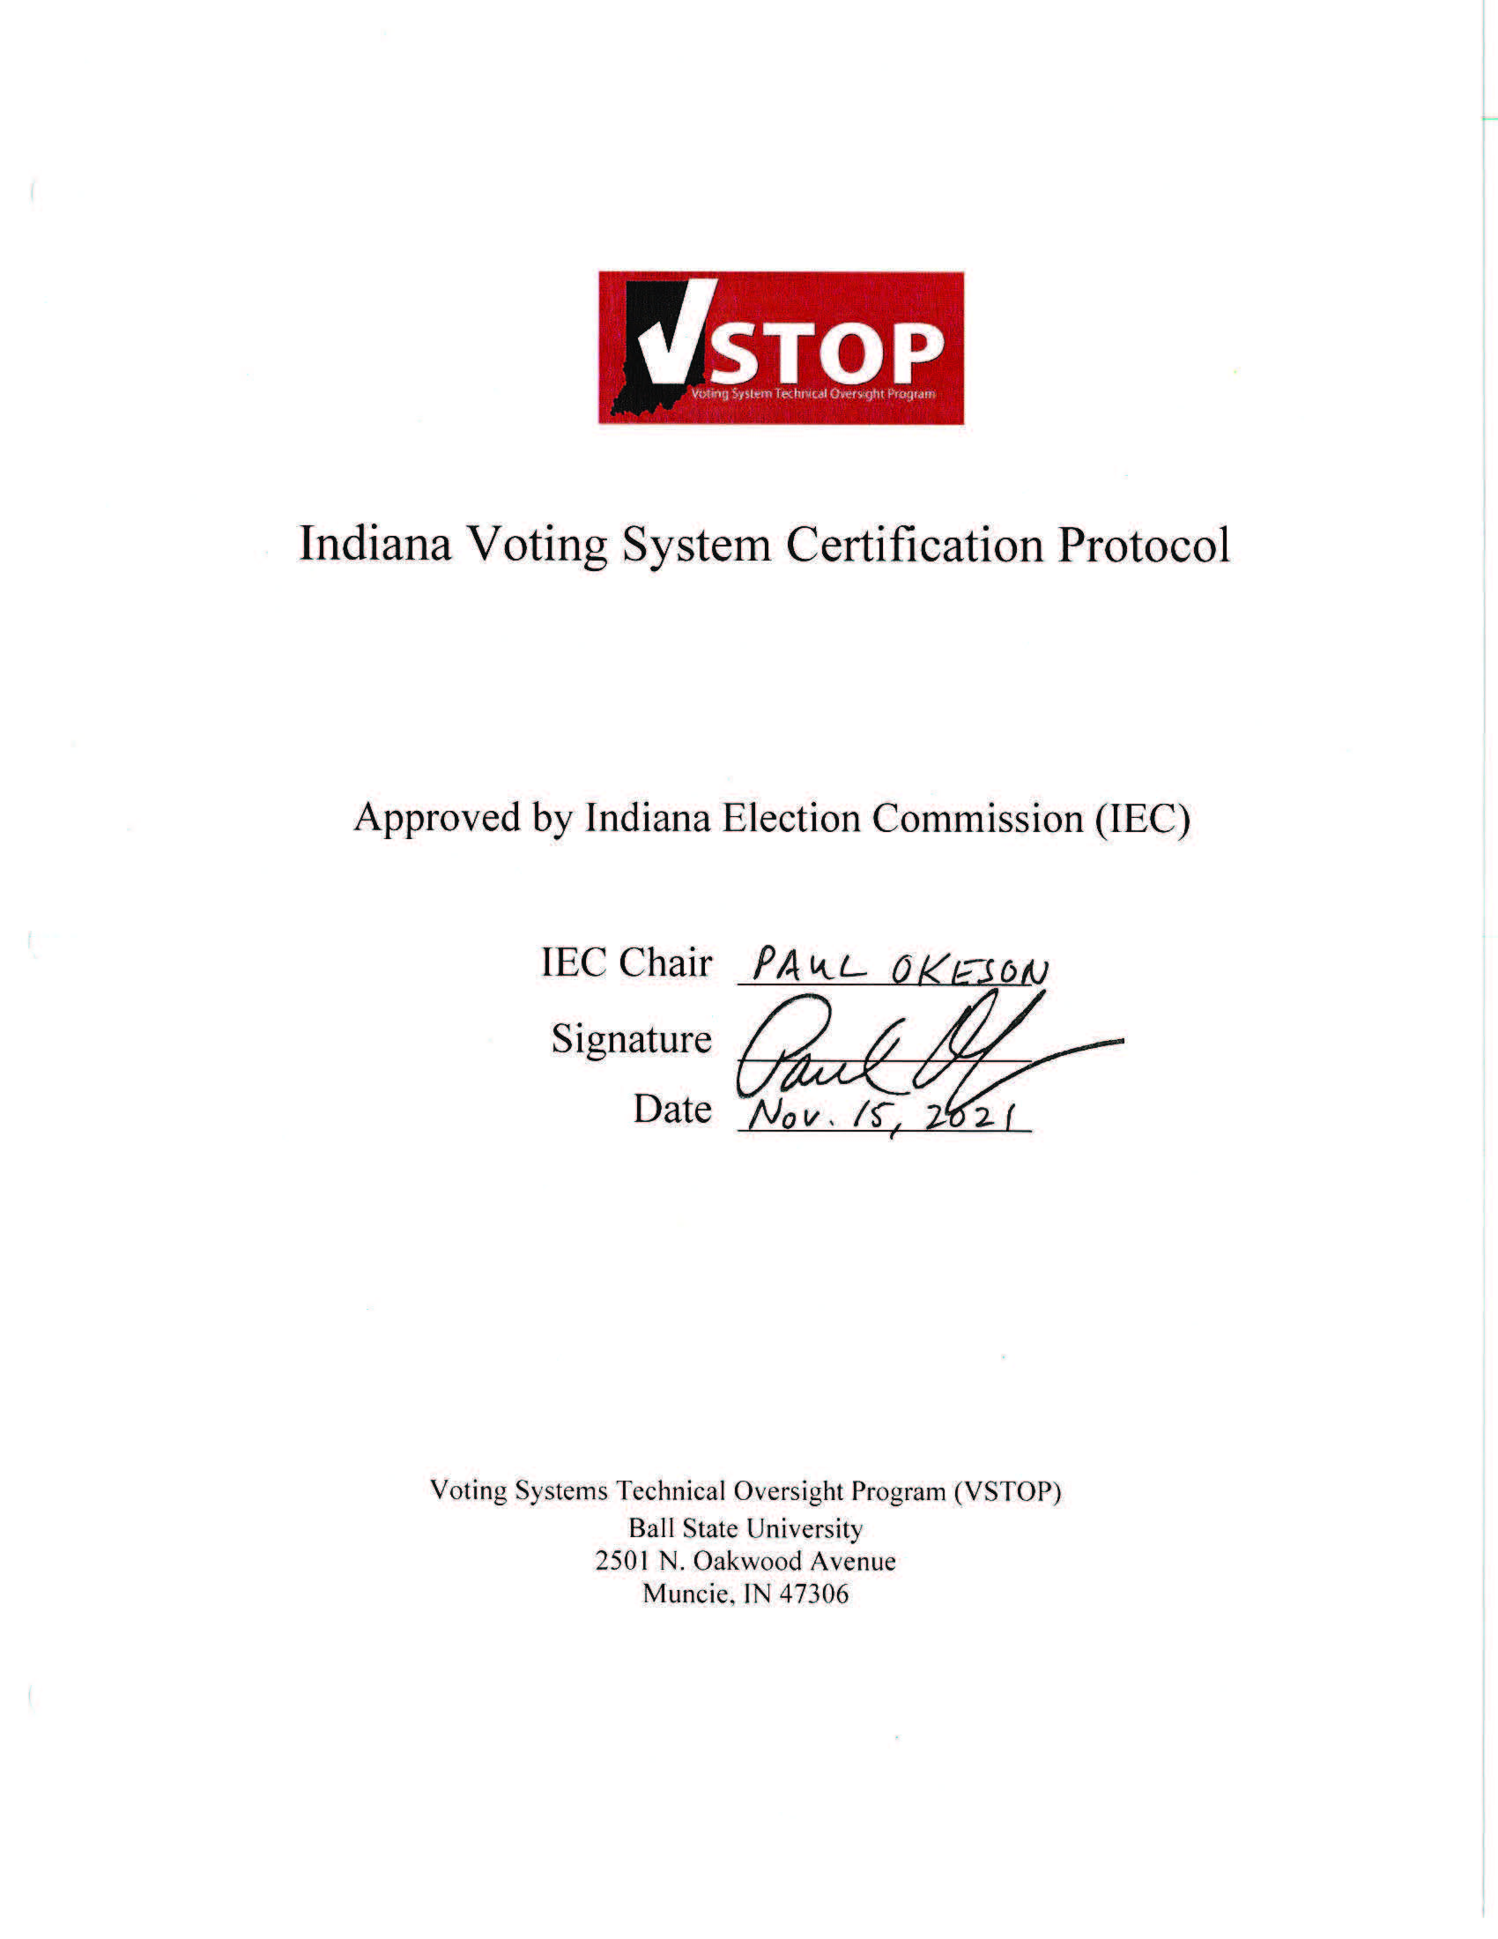
Indiana Voting System Certification Protocol History
Voting System testing protocol developed by VSTOP in collaboration with Indiana Election Division, Election Officials and Professionals in Indiana and others, Election Assistance Commission, Voting System Testing Labs, and ePB vendors
Constantly revised in accordance with current Indiana Code and technological advancements
Latest version approved by Paul Okeson, Indiana Election Commission Chair on November 15, 2021
Notes:
JB

Slide 4
The Voting System Certification Process
Administrative Review
Application and Documentation Review
Application fee for Voting System Certification is $5,000 per vendor/per version
Includes review of complete technical data package and all user and training materials
Mapping of Voting System functionality with the standards in Indiana Codes
Review of reports from National Lab Testing
Notes:
MC

Slide 5
The Voting System Certification Process
National Laboratory Testing
Physical Configuration Audit (PCA)
Source Code Review
System Level Testing
List of approved labs
Pro V & V Labs, Huntsville, AL
SLI Compliance, Denver, CO
Others may be added
Vendor pays all lab testing costs
Notes:
MC

Slide 6
The Voting System Certification Process
VSTOP Field Test
Thorough application review
Notarized Field-Testing Affidavit
Review of all hardware and software components
Review all security features, troubleshooting processes, election configuration, ballot creation and deployment, post-election tallies and result reports, and any additional features
Conduct ADA testing
Conduct Mock Election and confirm results match expected
Notes:
MC
Accessibility testing!

Slide 7
The Voting System Certification Process
Completed Field Test Recommendation by VSTOP to IED
Recommendation to approve
Recommendation to approve with conditions
Delayed recommendation if further testing or information is needed
IEC makes final decision regarding certification
Certification expires in 4 years or October 1st of the year following a Presidential Election
Notes:
MC

Slide 8
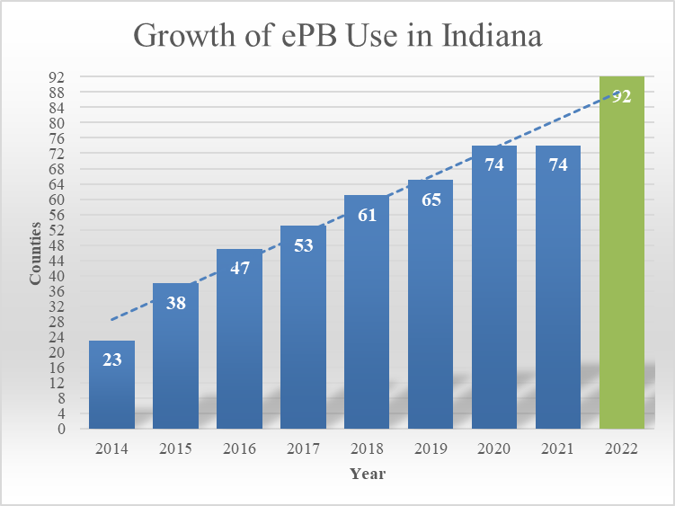
Growth of ePB use in Indiana
Notes:
DK

Slide 9
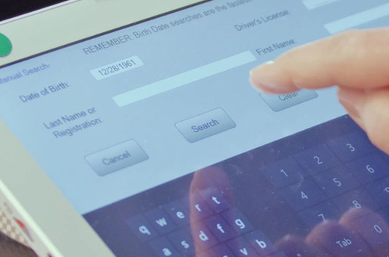
Indiana ePB Standards & Certification
Indiana was first in the United States to:
Establish electronic poll book (ePB) standards by law
Establish state certification system following testing and provide for regular renewal
One of 13 states currently certifying ePBs
National Conference of State Legislatures, 2014
Notes:
CK

Slide 10
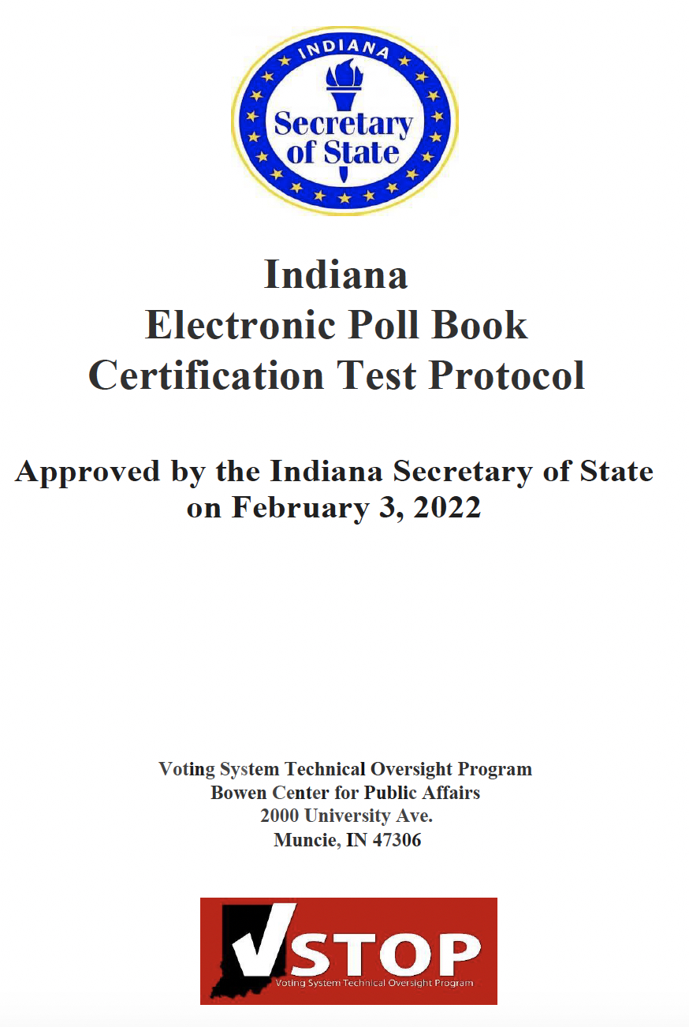
Indiana ePB Certification Protocol History
ePB testing protocol developed by VSTOP in collaboration with Indiana Election Division, Election Officials and Professionals in Indiana and others, Election Assistance Commission, Voting System Testing Labs, and ePB vendors
First version approved by Hon. Connie Lawson, 61st Secretary of State of Indiana on October 31, 2013
Constantly revised in accordance with current Indiana Code and technological advancements
Latest version approved by Hon. Holli Sullivan, 62nd Secretary of State of Indiana on February 3, 2022
Notes:
JB

Slide 11
The ePB Certification Process
Administrative Review
Application and Documentation Review
Application fee for ePB Certification is $1,500 per vendor/per version
Includes review of complete technical data package and all user and training materials
Confirmation from Vendors that their EPB solution meets the standards
Mapping of EPB functionality with the standards
Upon successful completion of this review, VSTOP will ask Vendor to proceed to Lab Testing
Notes:
MC

Slide 12
The ePB Certification Process
National Laboratory Testing
Functional Configuration Audit (FCA)
Telecommunications/Compliance Testing
List of approved labs
Pro V & V Labs, Huntsville, AL
SLI Compliance, Denver, CO
Others may be added
Standard Reporting Template
Vendor pays all lab testing costs
Notes:
MC

Slide 13
The ePB Certification Process
Web Services Framework Tests
SVRS communication
Accurate Voter information retrieval
Voter Check-In
Address unchanged?
Update address
Absentee voter status
Signature capture
Future WSF testing will address voter statuses from SVRS
Notes:
MC

Slide 14
The ePB Certification Process
VSTOP Field Test
Thorough application review
Notarized Field-Testing Affidavit
Review of all hardware and software components
Review report printing, pre-election tasks, troubleshooting, election configuration, voter check-in, post-election tasks, and any additional features
Conduct Mock Check-In and check results vs expected
Notes:
MC
Accessibility testing!

Slide 15
The ePB Certification Process
Completed Field Test Recommendation by VSTOP to SOS
Recommendation to approve
Recommendation to approve with conditions
Delayed recommendation if further testing or information is needed
SOS makes final decision regarding certification
Certification expires on December 1st of the following year
Notes:
MC

Slide 16
Ongoing Certification Activities
Hart Intercivic Verity 2.7
Field Testing Complete
Recommendation Report in the works
Recertification for ePBs
VR Systems
ES&S
Notes:
County Responses to Questions Proposed by VSTOP
We sent three questions to our panelists from Elkhart, Jay and Marion, and asked them to share their experience. We will now take one question at a time and invite our panelists to respond.
Question #1
Please provided a brief description of your experience with risk-limiting audits, including your experiences with RLA training, the RLA audit tool(s), and the RLA process.
Question #2
What are your recommendations for future counties who intend to participate in the RLA process?
Question #3
What thoughts do you have on the value of risk-limiting audits for your county?

Slide 17
Thank You!
Notes:
Closing Remarks
Some closing remarks from VSTOP, time permitting.

