Slide 1
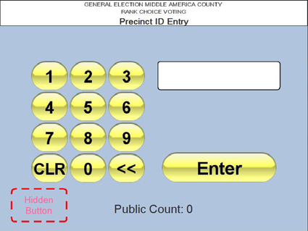
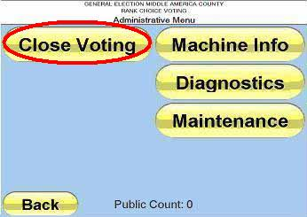
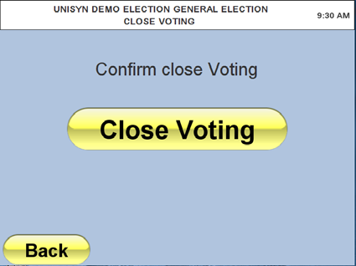
OVI – OpenElect Voting Interface
Closing The Polls - OVI
Unisyn Voting Solutions – Quick Reference Guide
STEP # 1
STEP # 2
Touch the “Hidden Button” on the bottom left side of the screen.
Enter Election Password
Press the “Close Voting” button as indicated above.
STEP # 3
STEP # 4
Confirm that you wish to close the voting process by pressing the “Close Voting” button that appears. Re-confirm close voting.
The OVI will prints an Election Summary Report which will indicate the total number of ballots printed throughout the day.
Election Summary
Election Title:
Unisyn County CA USA
General Election – 2010
Election Date: Tues Oct 12, 2010
Current Date:
Tues Oct 12, 2010 07:30:11 AM
Election ID: 106
Election Version: 77.4.6

Slide 2
Closing The Polls - OVI
Unisyn Voting Solutions – Quick Reference Guide
STEP # 5
Press “Back” button and then “Shutdown” button to power down OVI.
Once powered down turn the power switch in the back to the off position.
C. Wind the key pad cable and place the keypad back into the keypad holster.
D. Place OVI back in it’s carrying case for transport.

